Slide 1
Week 3
Peer Assisted Learning

Slide 2
Today’s Session
Math's for Computation
Inverting a 3x3 Matrix
Principles of Programming 2
Basic C
Intro to GDB (Including a Live Demo)
AI
MDP
Policies
Bellman Equations (with example from lectures)

Slide 3
Invert a matrix
We can calculate a inverse of a matrix in a few steps.
Step 1: We calculate the matrix of minors M_{m},
Step 2: We turn M_{m} into matrix of Cofactors M_{c} ,
Step 3: We turn M_{c} into adjugate matrix M_{T},
Step 4: We multiply M_{T} by 1 divide determinant.

Slide 4
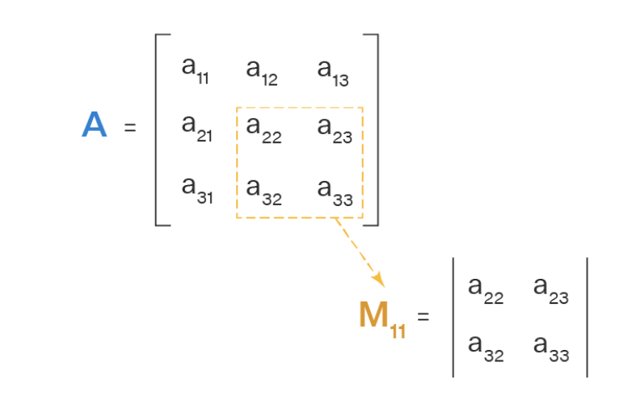
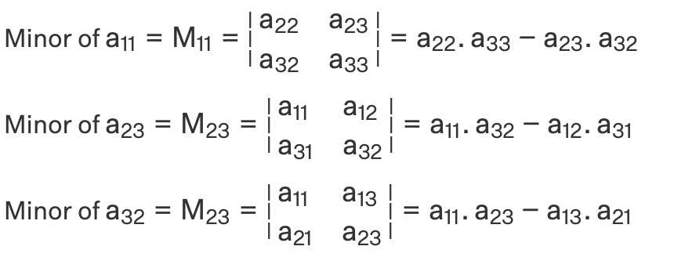
Step 1 :Matrix of minor
calculate the matrix of minors M_{m}
Similar to find determinant

Slide 5

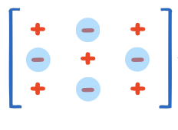
Step 2: matrix of Cofactors
turn M_{m} into matrix of Cofactors M_{c}
Multiply each element with positive sign
or negative sign based on this picture.
So if it is a 3X3 matrix ,you multiply
the matrix with this:

Slide 6
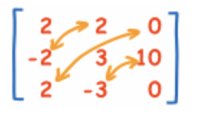
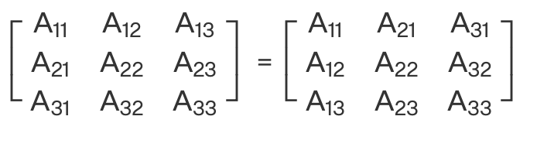
Step 3: adjugate matrix
turn M_{c} into adjugate matrix M_{T}
Swap all elements’ position over diagonal
M_{c} M_{T}

Slide 7
Step 4: multiply M_{T} by 1 divide determinant.
First, we need to find the determinant of the matrix.

Slide 8
What is the Determinant?
The determinant is just a number that we can calculate from a square matrix (matrix with same number of rows and columns).
If you would like to know more about the history behind it: History of Matrices
Why do we care about it? They are quite useful in helping us solve a system of linear equations or finding the inverse of a matrix (among other things).

Slide 9
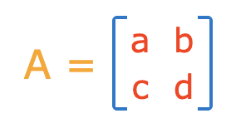
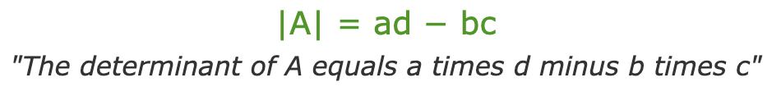
The Determinant of a 2x2 Matrix?

Slide 10
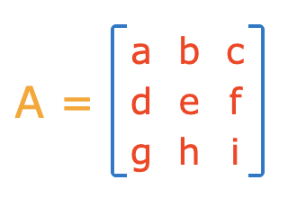
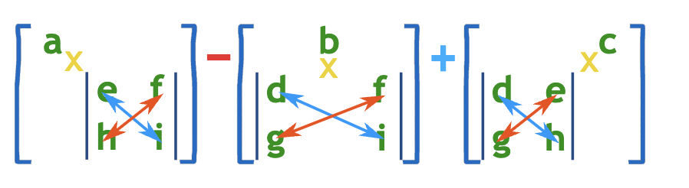
What about the determinant of an nxn matrix?
We can start by looking at a 3x3 matrix:
What is this saying?
Multiply a by the determinant of the 2x2 matrix that is found by ‘removing’ a’s row and column.
Do the same for b and c.
Sum them up, but put a negative in front of the b.
(We chose the top row, does it make a difference?)

Slide 11
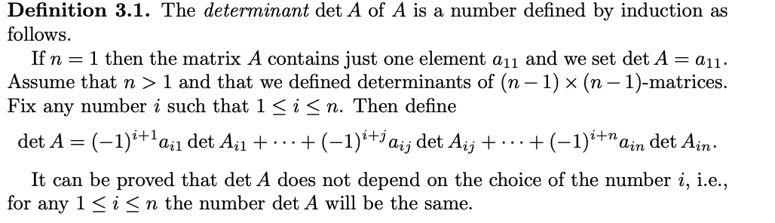
What about the determinant of an nxn matrix?
We can look at the fancy definition, but this is just a formal way of describing what we just did for the 3x3 matrix.

Slide 12
Step 4: multiply M_{T} by 1 divide determinant.
First, we need to find the determinant of the matrix.
Once we find the determinant of matrix , we simply multiply M_{T} with 1/ det(M)
Note: if determinant of a matrix A is zero , there is no inverse matrix of it.

Slide 13
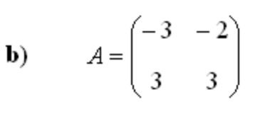
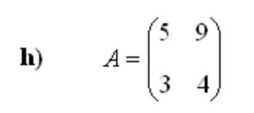
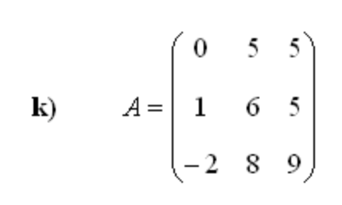
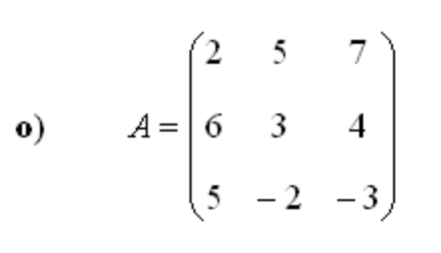
Practice

Slide 14
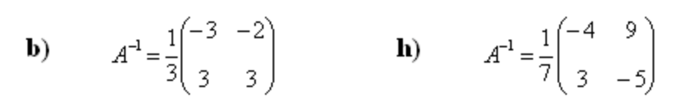
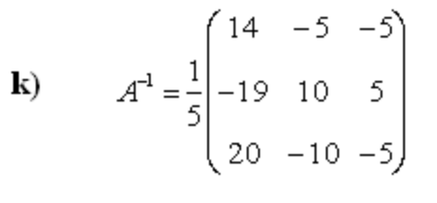
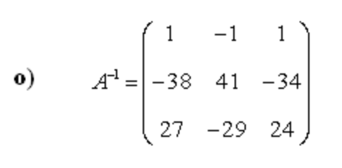
Answers

Slide 15
References/Sources
https://www.cuemath.com/algebra/minor-of-matrix/
https://www.mathsisfun.com/algebra/matrix-inverse-minors-cofactors-adjugate.html
https://math.mit.edu/~gs/linearalgebra/ila0205.pdf
https://www.math-exercises.com/matrices/inverse-matrix
https://www.mathsisfun.com/algebra/matrix-calculator.html

Slide 16
Introduction to GDB
GDB is a debugger for C, and is run on the command line.
Compiling a file:
gcc -Wall -g code.c -o code
-g: Compiles the code
-Wall: Just tells the compiler to report all warnings
-o: Places the compiled program into the file named code.
Can be named anything.
Notes:
There is a PDF on moodle which explains how to debug using GDB in more detail.

Slide 17
Running your program
To do this you would type: ./code
Compiled code is compatible on your current computer’s architecture.
So you would likely have to recompile code if you try to run it on another computer.

Slide 18
Other Commands
-Werror: Converts all warnings into errors. This will not run your code if there are any warnings present.
-Wextra: The same as Wall but includes more warnings.

Slide 19
Printing in C
Use printf instead of print/system.out.println
Printf(“Hello world”);
Format Placeholders:
Used to print variables from your code.
%d / %i - Integer
%f - Floating Point Number (%e does the same but in standard form)
%s – String
%c - Char
https://www.geeksforgeeks.org/format-specifiers-in-c/

Slide 20
Printing in C cont.
Escape Sequences
Used to represent characters which are used in syntax and for formatting output.
\n = New Line
\t = Tab
\” = d=Double quotes
\’ = Single quote/apostrophe
\\ =Backslash

Slide 21
Debugging in CLion (Live Demo)
Now it’s time for a demo, you can find the example used here:
https://github.com/jakedves/debugging-intro-clion

Slide 22
Markov Devision Process
Markov Property - Previous states do not matter. The path between states to get to the current state can be ignored.
Markov Decision Process – The reward and the new state St+1 depend only on the current state St at time t.
Consider an agent finding a good path through trees when skiing. It doesn’t need to take into account the path it took to get to where it is, but needs to only look at its current state/position. It could have taken 3 different routes to get to the current state, but we treat the situations as equal.

Slide 23
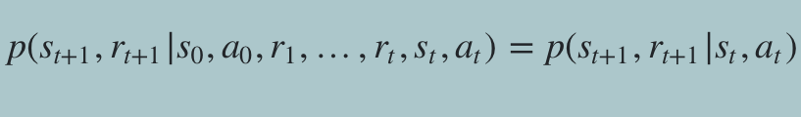
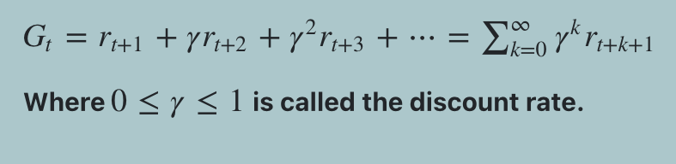
Markov Decision Process Written Formally
The objective of sequential processes, such as Tetris, is not to reach a goal state, but to maximise long-term reward.
The most commonly used metric is expected discounted return:
Discount rate 0
Only look at the next reward —> Gt = rt+1
Discount rate 1
Look at every action and therefore reward going forward

Slide 24
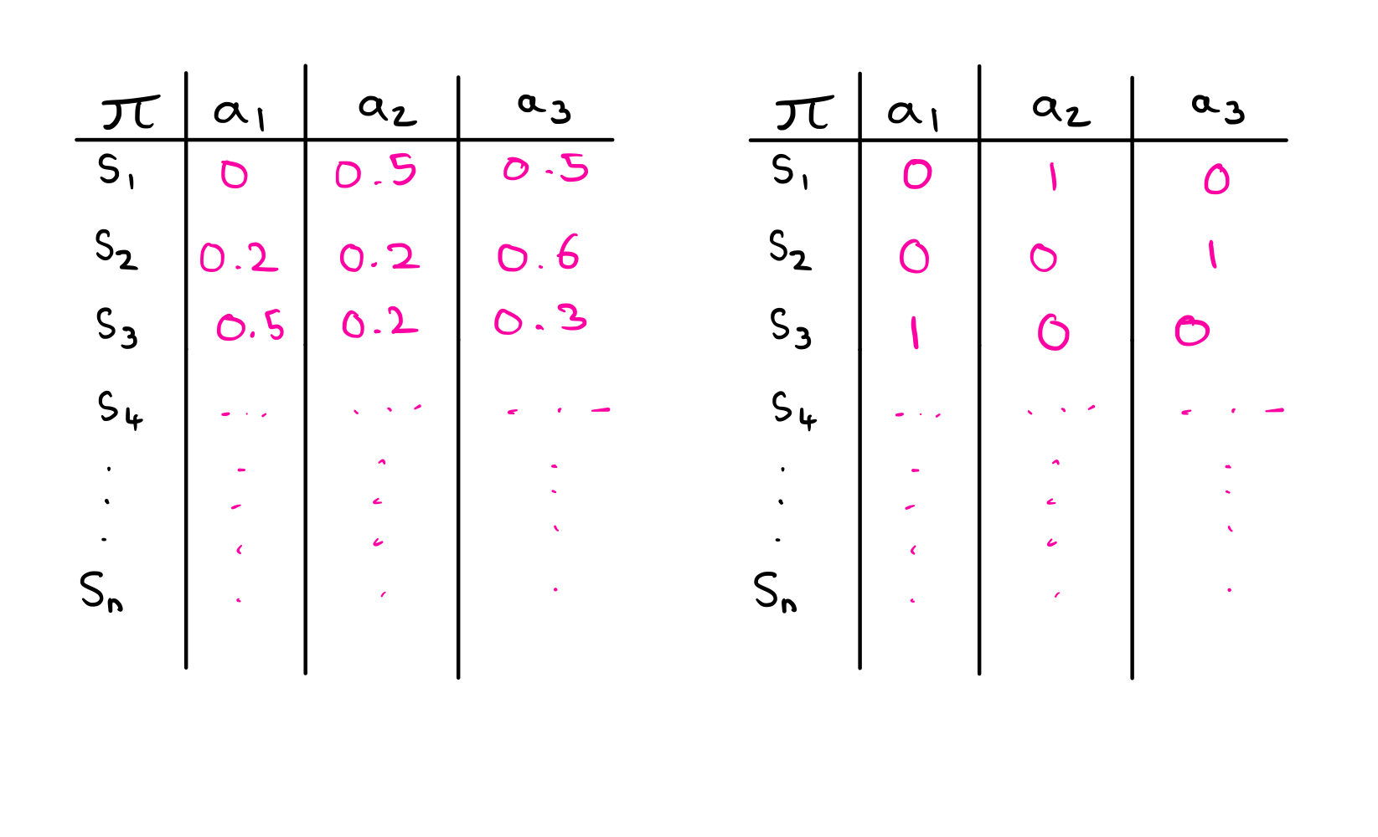
Policy
Policy – The probability of taking action a in state s. A policy can be stochastic or deterministic.
We want to find the optimal policy, which maximises the objective function.

Slide 25




State-Value Function
State-Value Function →
(The expected return when being in state s, following the policy π)

Slide 26





Bellman Equation - Quick Derivation
Exploiting its recursive property… ← make sense?
p(taking this action from this state)
*
p(getting to this state and getting this reward given that we start in the current state and take this action)
*
reward
Defined in notes as → Sum over all possible actions of the probability of taking that action, multiplied by the sum over all outcomes that can be obtained by taking that action, multiplied by the reward itself

Slide 27
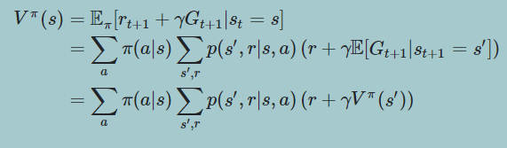
Bellman Equation

Slide 28
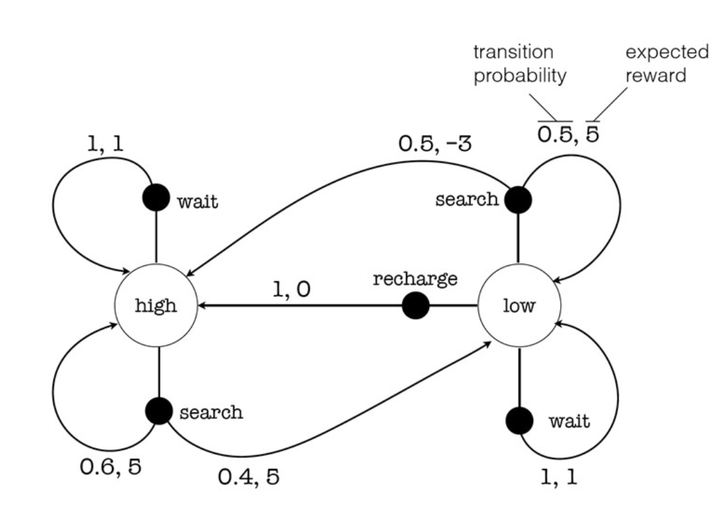
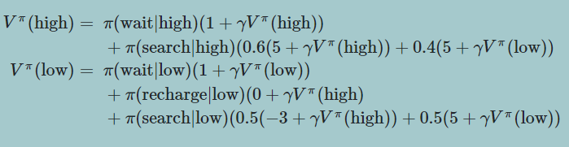
Bellman Equation - Example
π(wait | high) * (1) * (1 + discounted_rate(V^{π} (s’))
+
π(search | high) * [(0.6) * (5 + discounted_rate(V^{π} (s’)) + (0.4) * (5 + discounted_rate(V^{π} (s’))]

Slide 29
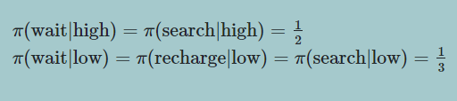
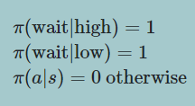
Bellman Equation - Example
Uniformly distributed
Deterministic (preferred)

Slide 30


Bellman Equation - Example
As we are only using deterministic policies we can try every possible combination of policy using this method to calc the optimal policy, V*.
Value iteration finds the optimal policy in a more appropriate way.

